Slide 1


INSPIRED CAPITAL
A New Approach to Measuring Performance and Achieving SUSTAINABLE BUSINESS SUCCESS in a Brave New World
Presented by:
Jonathan Quail
CEO, LIFEBUILD

Slide 2
PRESENTATION OVERVIEW
The BIG QUESTION
The Root Cause of the Problems
The DNA of a Visionary Organisation
The Ideal Organisation
What is Inspired Capital and Whole Wealth?
The Inspired Capital Index (ICI) System Explained
Phased Implementation Approach
Key Benefits of the ICI System
Summary and Conclusion
Lifebuild’s Contact Details
Challenges Faced by Organisations Today
Visionary vs. Ordinary Organisations

Slide 3

??THE BIG QUESTION??
How do organisations truly add value to their employees, customers and society as a whole and generate satisfactory ongoing profits in an ethical and sustainable way in today’s challenging environment?
“Sustainability is the single biggest business
opportunity of the 21st century… it will be the next
main source of competitive advantage.”
– Lee Scott, CEO, Wal-Mart

Slide 4
CHALLENGES FACED BY ORGANISATIONS
High Staff Attrition
High Absenteeism
Constant Internal Conflicts
High Levels of Fraud
Environmental Unfriendliness
Social Irresponsibility
Gender and Race Inequality
Pressure from Investors to Perform
Extremely Rapid Change

Slide 5
THE CHALLENGE OF CHANGE
The recent IBM Global CEO Study*
revealed the majority of CEO’s felt:
    Radical change is their biggest challenge
    Their organisations are ill-equipped to deal with this challenge of change
* IBM consultants interviewed 1,541 CEO’s and senior executives of organisations in 33 different industries and
60 countries between September, 2009 and January, 2010 – see www.ibm.com/ceostudy/uk for more information

Slide 6
ROOT CAUSE OF THE PROBLEMS
NEGATIVITY OF AN
ORGANISATION’S EMPLOYEES
“The significant problems we face can’t be solved
at the same level of thinking we were at when we
created them.” - Albert Einstein

Slide 7
CHALLENGES FACED BY ORGANISATIONS
Poor Productivity and No Innovation
Poor Product / Service
Entrenched Negative Values (e.g. Fear, Greed, Arrogance)
Loss of Competitive Advantage
Reduced Profitability or Losses
Low Morale, Apathy and Resistance to Change
Increased Risk of Business Failure

Slide 8
SCALE OF NEGATIVE MOTIVATIONS*
}
Maslow’s Belonging Needs
-1 Self-assertion / Pride
-2 Anger
-3 Craving / Greed
-4 Fear
-5 Anguish
-6 Apathy
-7 Guilt & Shame
-8 Depersonalisation
}
Maslow’s Security Needs
}
Maslow’s Survival Needs
* From the ‘Scale of Motivations’ created by Ian Marshall, a psychiatrist and
psychotherapist, based on over 40 years of clinical observations of patients

Slide 9
THE CHALLENGE OF CHANGE
The recent IBM Global CEO Study* revealed
the majority of CEO’s felt:
    Radical change is their biggest challenge
    Their organisations are ill-equipped to deal
    with this challenge of change
    Creativity and innovation are critical to
    their organisations’ future success
* IBM consultants interviewed 1,541 CEO’s and senior executives of organisations in 33 different industries and
60 countries between September, 2009 and January, 2010 – see www.ibm.com/ceostudy/uk for more information

Slide 10
VISIONARY VS. ORDINARY ORGANISATIONS
Year | Investment in Ordinary Fund* | Investment in Visionary Co.*
1926 | $1 | $1
1990 | $955 | $6,356
Return on Capital | 955% | 6,356%
Positive Employees
Committed to Org. Values
& Vision
High Job Satisfaction
Take Responsibility
Proactive & Take Initiative
Improved Productivity
Better Asset Utilisation
Innovation
Better Value Proposition
Sustainable
Competitive ADvantage
* According to research done by James Collins and Jerry
Porras for the book Built to Last
THE BOTTOM LINE:
665% more shareholder value created in the average visionary company
than in the average ordinary company => SUSTAINABLE GROWTH

Slide 11

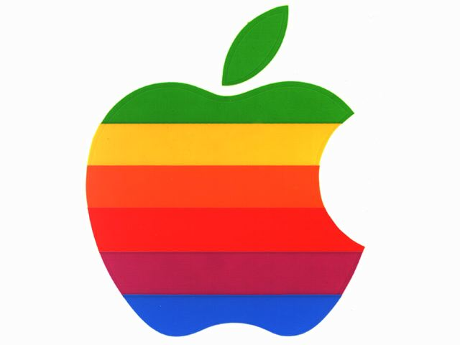


??THE BIG QUESTION??
What makes Google, Apple,
Facebook, Dell and other highly
successful businesses outperform average companies sustainably?

Slide 12
VISIONARY ORGANISATIONS
MARKET CAP. (AS AT 01/07/2011) | P/E RATIO | LATEST ANNUAL NET INCOME | 7- YEAR SHARE PRICE GROWTH*
$167.9 B | 20.23 | $8.5 B | 505%
$317.43 B | 16.35 | $16.64 B | 1,093%
$20 - $40 B** | N/A | N/A | N/A
The most successful businesses in the world, e.g. Google
Apple
Facebook
have:
  Happy, motivated staff
  High levels of innovation
  High profits and market share
  Sustainable growth and success
AVG EMPLOYEE SATISFACTION*
3.9
3.8
4.6
* According to a survey of employee satisfaction in leading IT companies done
by Glassdoor.com in October 2010 based on min. 50 reviews per company
* Measured between 19/08/2004 and 30/06/2011
** This is an estimate, as Facebook is not yet a publicly listed company

Slide 13
CASE STUDY: GOOGLE
‘Googlers’* say they are ‘helping to organise
the world’s information to make it
universally accessible and useful’
Zero staff turnover a few years ago, now
losing staff to Facebook
Software engineers spend 20% of their time
on projects that interest them
New products like Adsense, Gmail, Google
News and Orkut created as a result
* The slang name at Google for Google employees

Slide 14
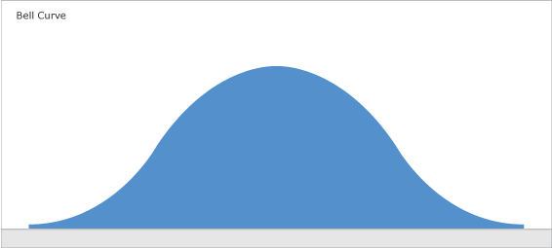

ORGANISATIONAL SHIFT
No. of Employees
Negative Motivational States
Positive Motivational States

Slide 15
SCALE OF POSITIVE MOTIVATIONS*
}
+8 Enlightenment
+7 World soul
+6 Higher service
+5 Creativity & Generativity
+4 Mastery
+3 Power within
+2 Gregariousness & Cooperation
+1 Exploration
Maslow’s Peak Experiences
}
Maslow’s Self-actualisationNeeds
}
Maslow’s Self-esteem Needs
* From the ‘Scale of Motivations’ created by Ian Marshall, a psychiatrist and
psychotherapist, based on over 40 years of clinical observations of patients

Slide 16
VISIONARY VS. ORDINARY ORGANISATIONS
“Doing well and doing good are not
opposites, they’re companions.”
– Director of Corporate Social
Responsibility, Starbucks

Slide 17
THE DNA OF A VISIONARY ORGANISATION
Values are like the organisation’s DNA
A blueprint for success or dis-ease
Positive shared values create healthy DNA and
success
Negative shared values create unhealthy DNA
and failure
“Without respect, the subtle alchemy that binds an
organisation or that serves as the impetus for a
business transaction would dissolve into mutual
suspicion and hostility.”
– Mihaly Csikszentmihalyi, expert on the
phenomenon of ‘flow’ in life and business

Slide 18

CULTURAL BLUEPRINT
The collective values of the people working for the organisation create a cultural blueprint (cf. DNA) for success or failure that manifests in the organisational structure and activities

Slide 19
THE AQAL INTEGRAL MODEL*
Individual
SPIRIT
SOUL
‘I’
‘It’
Intentions
Behaviours
MIND
Interior
Exterior
BODY
Systems
Culture
‘We’
‘Its’
Collective
* The All-Quadrant, All-Level Integral Model developed by Ken Wilber

Slide 20
THE IDEAL ORGANISATION
2 - 5%
Servant Leaders (+6)
Special Function Masters (+4)
10 - 15%
80%
(+1, +2, +3)
Most employees - people who will raise their motivational level if properly led and guided
5%
Employees who will not shift their level of motivation

Slide 21
THE FRACTAL ORGANISATION
‘Hot Spot’
Problem Area

Slide 22
WHAT IS WHOLE WEALTH?
WHOLE WEALTH is that which we have access to permanently and continuously that enhances the quality of whole life for ourselves, our fellow human beings and all other sentient life

Slide 23
WHAT IS INSPIRED CAPITAL?
Inspired Capital is the extent to which positive motivations are felt
and acted on by people in an organisation to create Whole Wealth for an organisation, its customers, employees, stakeholders, partners and society as a whole

Slide 24
4 PILLARS OF INSPIRED CAPITAL
ONE MEASURE?
INSPIRED CAPITAL
HUMAN
CAPITAL
FINANCIAL
CAPITAL
SOCIAL
CAPITAL
ENVIRONMENTAL CAPITAL

Slide 25
A SIMPLE TRUTH
What is measured in an organisation is…
WHAT GETS MANAGED!

Slide 26
THE AQAL INTEGRAL ORGANISATIONAL MODEL*
Individual
SOUL
MEANINGFUL
Intentions
Behaviours
WHOLE
WEALTH
Interior
Exterior
VALUE/S
X
LEVERAGE
Systems & Processes
Culture
Collective
* Based on the All-Quadrant, All-Level Integral Model of Ken Wilber

Slide 27
FORMULA FOR TRANSFORMATION
WEALTH = VALUE X LEVERAGE
INSPIRED CAPITAL INDEX (ICI)
=
VALUES INDEX (VI)
X
SYSTEMS INDEX (SI)

Slide 28
FORMULATING THE VALUES INDEX
SURVEYING
FORMULATION
MEASUREMENT
OPINIONS ON VALUES
THEMATIC GROUPING
ELECTIONS
TOP 10 VALUES
MATHEMATICAL FORMULA
VISUAL EXPRESSION
VISION FORMULA
MEASURE FREQUENCY
OF
OCCURRENCE
CALIBRATE ON
TONE SCALE
10. CALCULATE
FORMULA
VALUE

Slide 29

MEASURING THE VALUES INDEX
Step 1 – Survey
Ask all employees what they think the 30 most prominent values being expressed in the organisation are

Slide 30
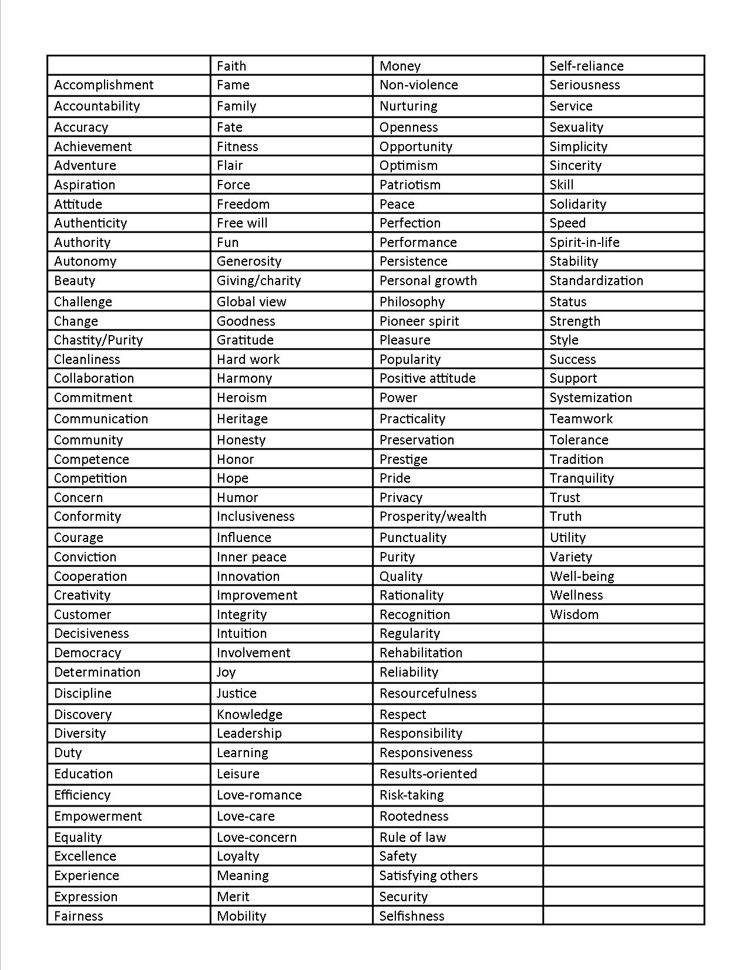
MEASURING THE VALUES INDEX
Step 2 – Thematic Grouping
The common themes from the survey results are extracted to create a list of all the values employees feel are being expressed in the organisation

Slide 31
MEASURING THE VALUES INDEX
Step 3 – Election of Top 15 Values
Election by all employees of the 15 values they feel are most prominently felt and acted out in the organisation
A list of the top 15 organisational values is compiled

Slide 32

MEASURING THE VALUES INDEX
Step 4 – Second Election & Top 10 Ranking
All employees and important customers, suppliers and partners select the 10 most important values leading to the organisation’s success or failure and rank them from 1 to 10

Slide 33
MEASURING THE VALUES INDEX
Step 5 – Formulating the Cultural DNA
A mathematical formula with the 10 top organisational values with log weightings to show the relative importance of each value is created, e.g.
Integrity³ + Enthusiasm² + Customer Care² +
Diligence + √Innovation + Fear of Failure³ +
(Laziness & Complacency)² + Stress² +
Bureaucracy + Excessive Focus on Profit

Slide 34

MEASURING THE VALUES INDEX
Step 6 – Symbolic Formula Expression
The best ideas from employees for expressing the values in the formula as images are used to create a visual, intuitive language that helps people connect emotionally with the values

Slide 35

MEASURING THE VALUES INDEX
How do you feel when you read the word
‘Integrity’
as opposed to seeing…

Slide 36
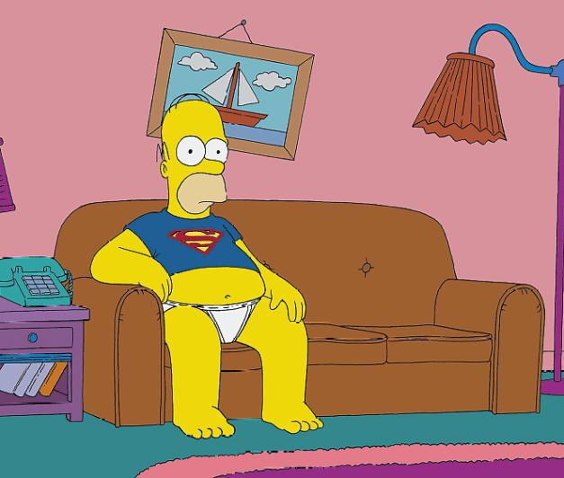
MEASURING THE VALUES INDEX
How do you feel when you read the words
‘Laziness & Complacency’
as opposed to seeing…

Slide 37
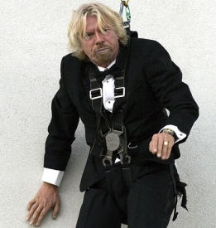


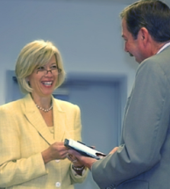


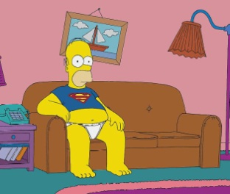
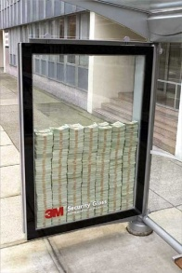


MEASURING THE VALUES INDEX
Step 6 – Symbolic Formula Expression
3
2
2
√
+
+
+
+
Integrity
Enthusiasm
Customer Service
Diligence
Innovation
3
2
2
+
+
+
+
+
Fear of Failure
Laziness & Complacency
Stress
Bureaucracy
Profit Focus

Slide 38
MEASURING THE VALUES INDEX
Step 7 – Formula Communication & Vision
Values Survey
The discovered VI formula is communicated to all the organisation’s employees
They are asked what they think the top 10 values of the organisation should be to align the organisation with its long-term vision

Slide 39

FORMULATING VISION VALUES
Step 8 – Vision Formula Conceptualisation
A ‘Vision Formula’ is produced where the negative values in the Values Index are ‘flipped’ into their opposite positive ones and the positive ones are magnified, e.g.
Integrity³ + Enthusiasm³ + Customer Care² + Innovation² + Diligence + Faith in Success³ + (Proactivity & Productivity)² + Having Fun² + Self-reliance + Quality Focus

Slide 40
FORMULATING VISION VALUES
Step 9 – Vision Formula Expression
The best ideas from employees for symbolically expressing the values in
the Vision Formula are used to create images that connect people emotively with the organisation’s Vision Values

Slide 41

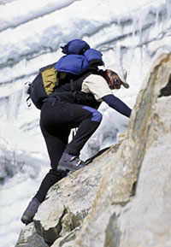
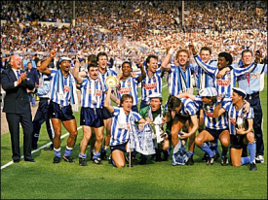



FORMULATING VISION VALUES
Step 9 – Vision Formula Expression
2
3
2
3
2
√
+
+
+
+
Integrity
Enthusiasm
Customer Service
Diligence
Innovation
3
2
2
+
+
+
+
+
Laziness & Complacency
Proactivity &
Productivity
Having Fun
Stress
Bureaucracy
Quality Focus
Faith in Success
Profit Focus
Fear of Failure
Self-reliance

Slide 42
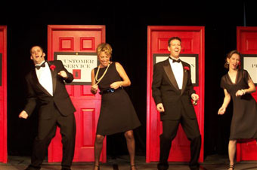
COMMUNICATING THE VALUES & VISION
Step 10 – Launch of the Formulae
The Values and Vision Formula are communicated using an experiential process (e.g. corporate theatre) and a Culture Dictionary to help people to connect emotionally with them

Slide 43
COMMUNICATING THE VALUES & VISION
Step 11 – Vision Formula Production
Physical versions of the Vision Values are produced and displayed in a prominent location in the organisation where employees and clients will regularly see the formula

Slide 44
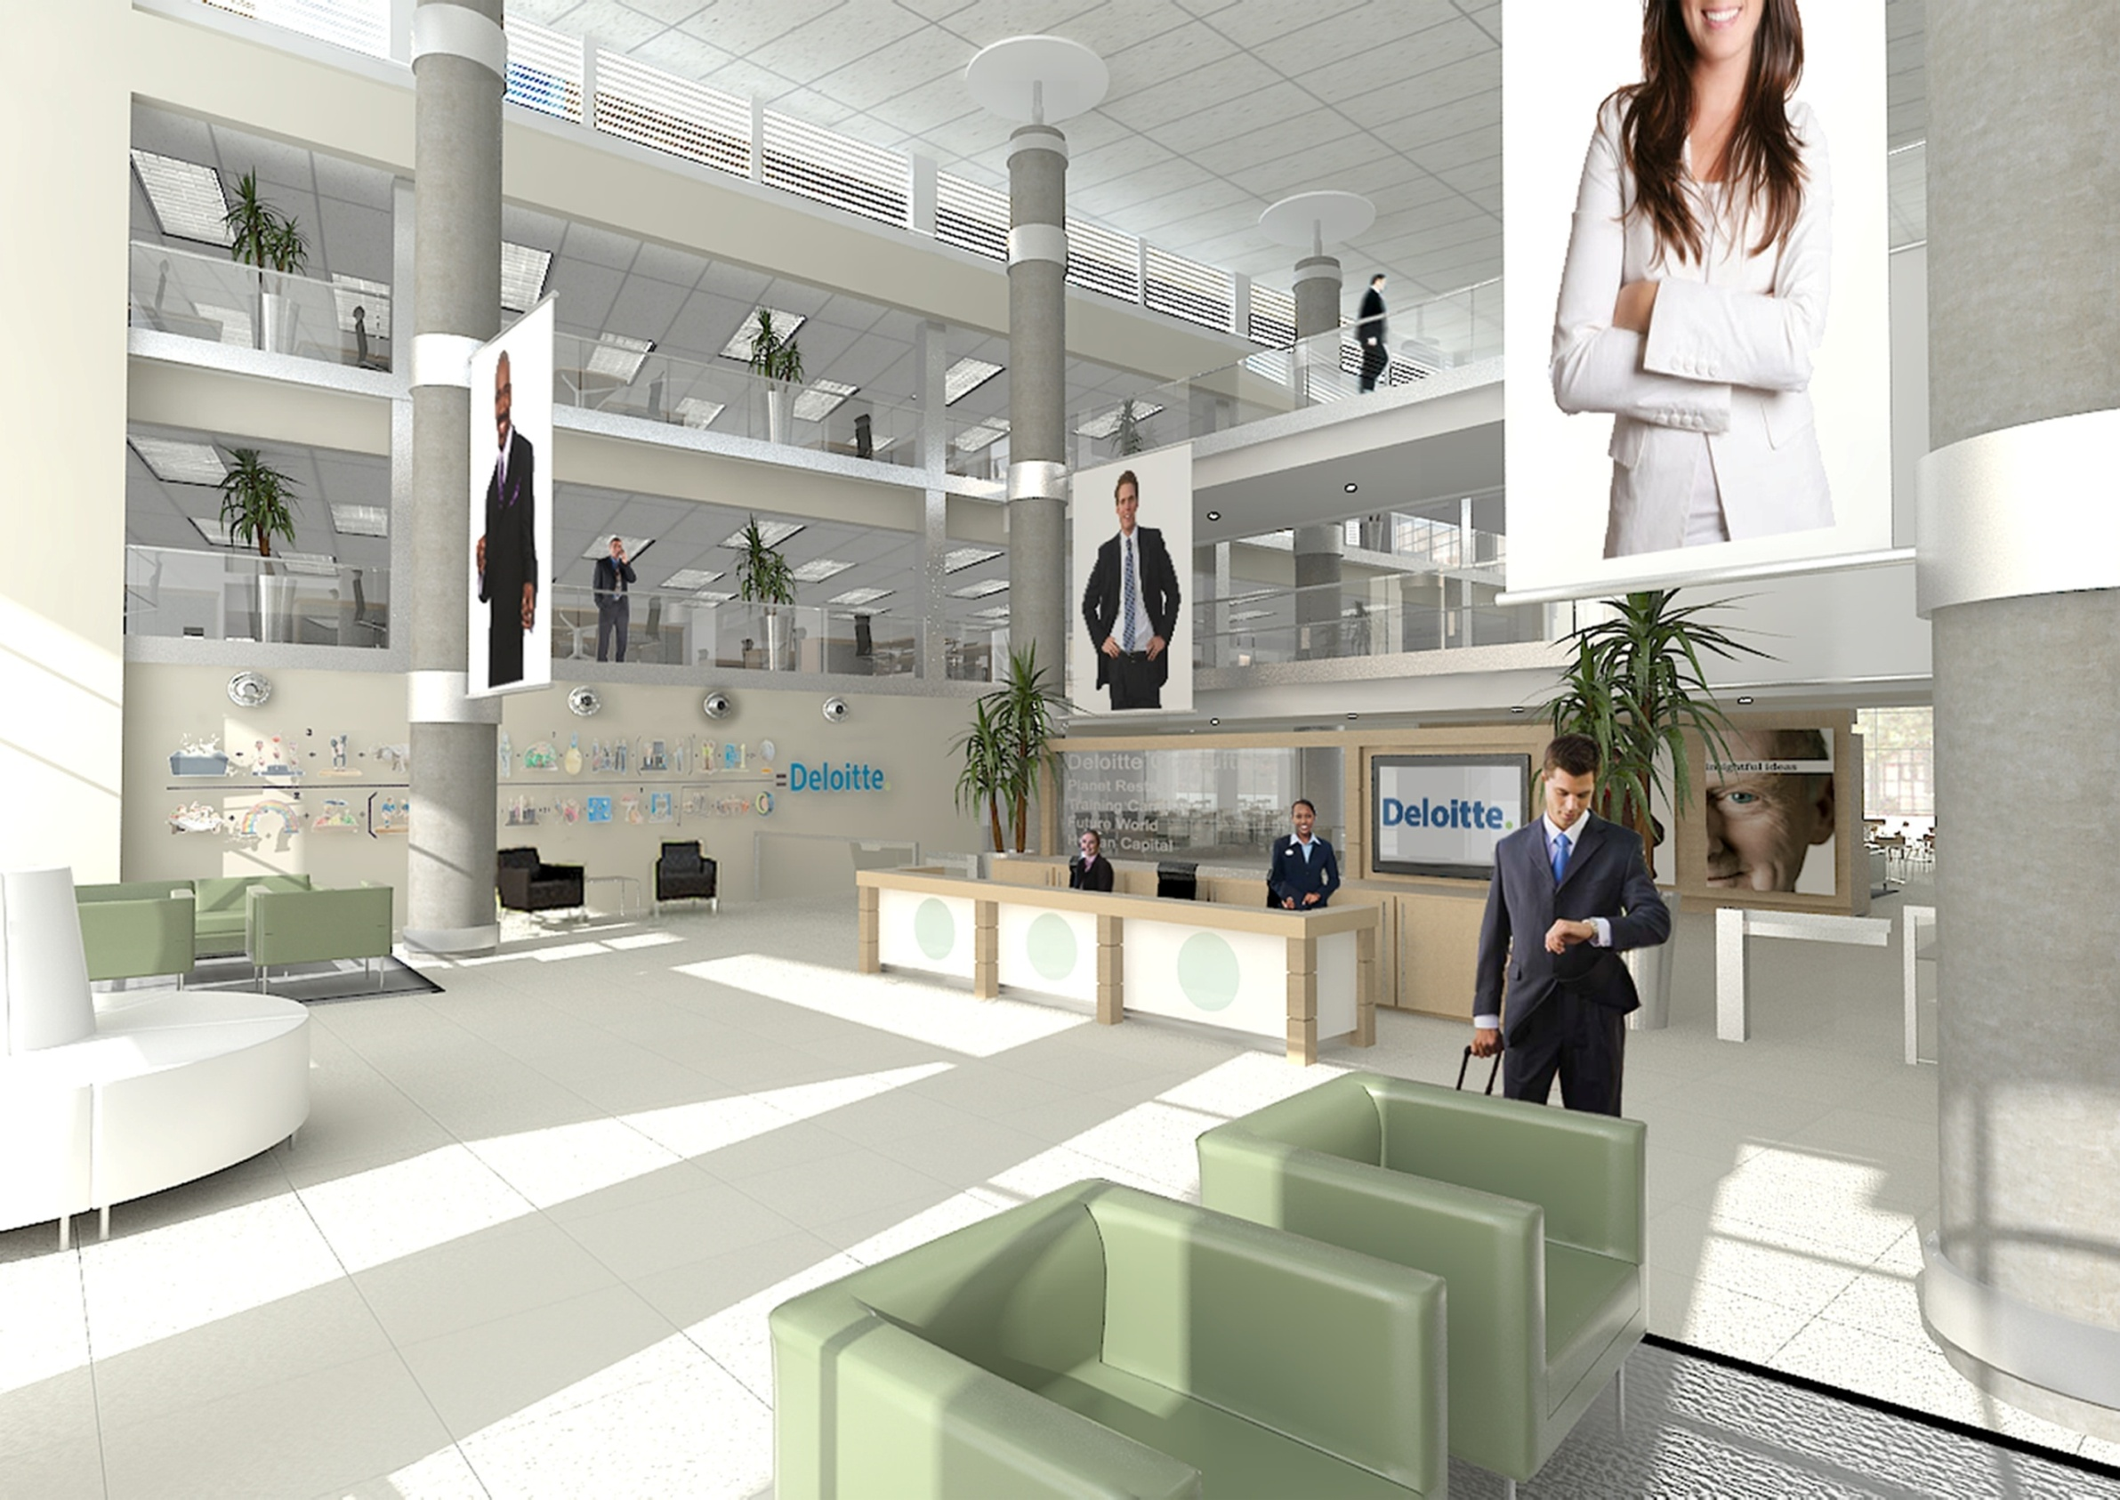

Slide 45
MEASURING THE VALUES & VISION
Step 12 – Measurement of Frequency
Employees score on the perceived frequency of occurrence of the Values and Vision formula values on a scale of 1 (negligible) to 10 (all pervasive)
An average is calculated for each value

Slide 46
THE INSPIRATIONAL TONE
Step 13 – Inspirational Tone of Values
Each of the values in the IVI and
Vision formulas is calibrated on the
Scale of Motivations to determine its
Inspirational Tone (IT) or strength

Slide 47
MEASURING THE VALUES INDEX
Step 14 – Calculation of Values Indices
The numeric value of the Values and
Vision Values formulae is calculated
by multiplying the average frequency
of each value by its Inspirational Tone
(IT) and putting these numbers into the
formulae

Slide 48
MEASURING THE VALUES INDEX
Step 14 – Calculation of the VI & Vision Values
Example 1:
Bureaucracy = 7 (frequency) x -4 (tone)
= -28
Example 2
Integrity = [6 (frequency) x +4 (tone)]³
= 13,824

Slide 49
MEASURING THE VALUES INDEX
Value | Frequency | Tone | Importance | Formula Value
Integrity | 6 | 4 | 3 | 13,824
Enthusiasm | 5 | 4 | 2 | 400
Customer Care | 7 | 4 | 2 | 784
Diligence | 5 | 3 | 1 | 15
Innovation | 3 | 1 | √ | 2
Fear of Failure | 7 | -4 | 3 | -21,952
Laziness & Complacency | 6 | -6 | 2 | -1,296
Stress | 7 | -3 | 2 | -441
Bureaucracy | 7 | -4 | 1 | -28
Excessive Focus on Profit | 8 | -4 | 1 | -32
 |  |  | TOTAL | -8,724

Slide 50
MEASURING THE VI 2 YRS ON
Value | Frequency | Tone | Importance | Formula Value
Integrity | 8 | 5 | 3 | 64,000
Enthusiasm | 7 | 5 | 3 | 42,875
Customer Care | 9 | 5 | 2 | 2,025
Diligence | 7 | 3 | 1 | 21
Innovation | 5 | 5 | 2 | 625
Fear of Failure | 5 | -4 | 2 | -400
Laziness & Complacency | 4 | -6 | 1 | -24
Stress | 5 | -3 | 1 | -15
Bureaucracy | 5 | -4 | 1 | -20
Excessive Focus on Profit | 6 | -4 | √ | -5
 |  |  | TOTAL | 109,082

Slide 51
MEASURING THE VALUES INDEX
Step 15 – Regular Scoring & Evaluation
Every month or quarter, employees and key
stakeholders of the organisation score on the
frequency of occurrence of all the values and
give qualitative feedback
Allows management to see how the values
are being lived in different parts of the
organisation and how to improve

Slide 52
MEASURING THE VALUES INDEX
Step 16 – Repeating the Process
Discovering and communicating the Values Index
and Vision Values formulas is repeated every 2 - 3
years to:
    Ensure that everyone in the organisation knows what values are driving it
    Is continuously improving their own values
    Align their behaviour with the organisation’s latest Vision Values

Slide 53
FORMULA FOR TRANSFORMATION
WEALTH = VALUE X LEVERAGE
INSPIRED CAPITAL INDEX (ICI)
=
VALUES INDEX (VI)
X
SYSTEMS INDEX (SI)

Slide 54
MEASURING THE SYSTEMS INDEX
Discovering and measuring the Systems Index (SI) is done using the same process as used for the Values Index
Actual and Desired Behaviours and Systems & Processes are determined and measured for each functional department / business unit

Slide 55
MEASURING THE SYSTEMS INDEX
The SI is calculated for each functional
department and / or business unit in the
following way*:
Behaviour Index (BI)_{Dept}
+
Systems & Processes
Index (SPI)_{Dept}
SI_{Dept} =
* The Behaviour and Systems & Processes Indices may be consolidated into
one index if this is deemed to be practical by the particular organisation

Slide 56
MEASURING THE SYSTEMS INDEX
The SI for the whole organisation is
calculated by averaging the SI values
for each department / business unit:
SI_{Mkting} + SI_{Accnts} + SI_{X} + … + SI_{N*}
SI_{Org} =
N*
* N = Number of departments and therefore, terms in the numerator

Slide 57
FORMULA FOR TRANSFORMATION
WEALTH = VALUE X LEVERAGE
INSPIRED CAPITAL INDEX (ICI)
=
VALUES INDEX (VI)
X
SYSTEMS INDEX (SI)

Slide 58
FORMULA FOR TRANSFORMATION
WEALTH = VALUE X LEVERAGE
INSPIRED CAPITAL INDEX (ICI)
=
VALUES INDEX (VI)
X
SYSTEMS INDEX (SI)

Slide 59
INDIVIDUAL SUCCESS FORMULAS
Every individual in the organisation will determine his or her own Actual and Vision Values and Actual and Desired Behaviours
Regular scoring by the person, their manager and peers will…
Align their values and behaviour
with the organisation’s Vision Values and their department’s Desired Behaviours

Slide 60
WHAT IS THE BOTTOM LINE?
ICI ALIGNS YOU FOR TAKE-OFF!
EXECUTIVE MOTIVATIONS & VISION
DIVISIONAL MOTIVATIONS & SYSTEMS
INDIVIDUAL MOTIVATIONS & BEHAVIOURS
INSPIRED VALUES
VALUES

Slide 61
WHAT IS THE BOTTOM LINE?
The bottom-line financial impact and
ROI of implementing the ICI can be
accurately predicted through the
Pinpoint Process
Converts the long-term vision and
strategy of the organisation into…
A detailed forecast balance sheet and
income statement for the next 10 years

Slide 62
WHAT IS THE BOTTOM LINE?
The model allows detailed comparisons
between historical data and strategic
forecasts to be made and bridges
THE GREAT DIVIDE
by accurately translating the non-
financial ICI value drivers into detailed
financial forecasts

Slide 63
THE GREAT ACCOUNTING DIVIDE
HISTORIC
ACCOUNTING
PRESENT
OPERATIONS
STRATEGIC
PLANNING
BALANCE SHEET
INCOME STATEMENT
CASH FLOW
STATEMENT
??
BUDGETS
SCENARIO
PLANNING
FINANCIAL
PROJECTIONS
KPI’S
REGULAR CASH FLOW STATEMENTS
LAGGING
INDICATORS OF PERFORMANCE
LEADING
INDICATORS
OF
PERFORMANCE
PREDICTED PERFORMANCE
FINANCIAL REPORTING
REGULAR MEASUREMENT
FINANCIAL FORECASTING

Slide 64
BRIDGING THE GREAT DIVIDE
HISTORIC
ACCOUNTING
PRESENT
OPERATIONS
STRATEGIC
PLANNING
BALANCE SHEET
INCOME STATEMENT
CASH FLOW
STATEMENT
ICI VALUE DRIVERS
REGULAR ICI SCORING
VALUES-BASED ACCOUNTING
??
BUDGETS
SCENARIO
PLANNING
PINPOINT
PROJECTIONS
LAGGING
INDICATORS OF PERFORMANCE
LEADING
INDICATORS OF PERFORMANCE
PREDICTED PERFORMANCE
FINANCIAL REPORTING
REGULAR MEASUREMENT
FINANCIAL FORECASTING

Slide 65
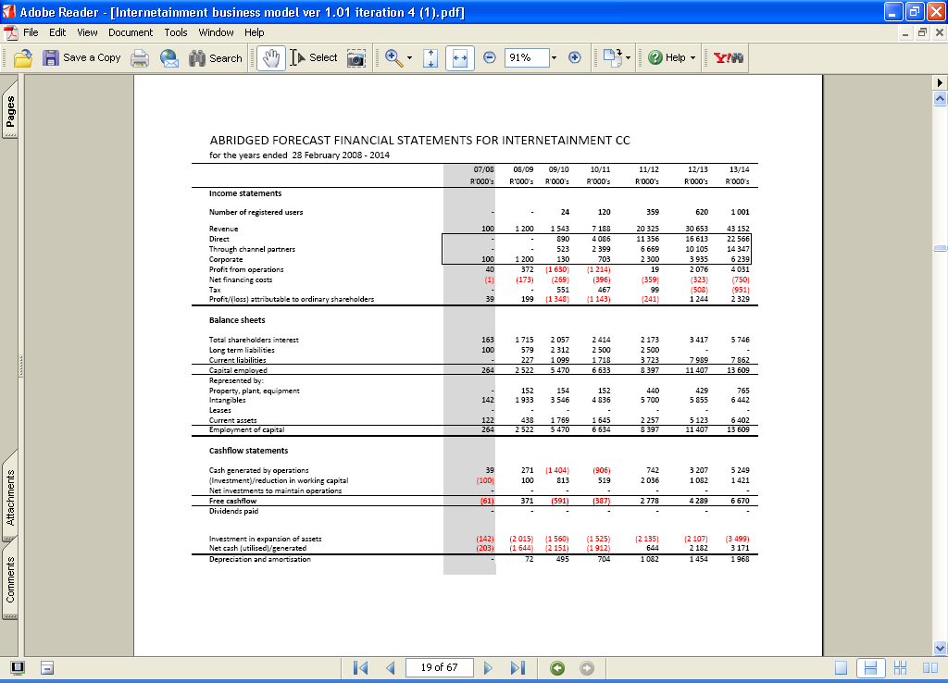
WHAT IS THE BOTTOM LINE?
GIVING YOU…
HINDSIGHT
NOW!

Slide 66
VALUES-BASED ACCOUNTING
The ICI model is the starting point
for the development of Values-based
Accounting (VBA) standards
organisations use for making
management decisions
Financial accounting will be used as
the final benchmark of performance
and for reporting purposes

Slide 67
PHASES OF ICI IMPLEMENTATION
Formulation of VI and Vision Values
(3 to 6 months)
Formulation of the SI (3 to 6 months)
Creation of Pinpoint Process 10-year
forecast (1 month)
Formulation of individual values and behaviours (3 to 6 months)
Repeating phases 1 to 4 (every 2 - 3 years)
An organisation’s only source of sustainable competitive
advantage is its ability to continuously learn, grow and improve

Slide 68
KEY BENEFITS OF THE ICI SYSTEM
Inspired Values
Inspired Action
Greater Productivity and Higher Innovation
Inspired Results
Better Products and Services
Sustainable Competitive Advantage
Inspired Capital
Inspired Corporate Culture
Happier, More Motivated Employees
Human, Social, Environmental & Financial Capital and
Whole Wealth Harmoniously Created for the Organisation, its Direct Stakeholders and Society
INSPIRED VALUES drive POSITIVE BEHAVIOUR which leads
to OUTSTANDING RESULTS that strengthen the VALUES

Slide 69
SUMMARY
Implementing the Inspired Capital Index performance
measurement system in an organisation will:
by:
Significantly improve the employees’ productivity and
innovation levels
Ensure sustainable long-term growth, profitability and
competitive advantage
Build Inspired Capital for the organisation and its
stakeholders and Whole Wealth for society …
Continuously measuring the extent to which the employees are
aligned with the collectively agreed values and vision
Progressively transforming their values so they become more
and more inspired and motivated to act in ways that serve both
the organisation’s stakeholders and the highest good of society

Slide 70
ORGANISATIONAL TRANSFORMATION
No. of Employees
Negative Motivational States
Positive Motivational States

Slide 71
??THE BIG QUESTION??
How do organisations truly add value to their employees, customers and society as a whole and generate satisfactory ongoing profits in an ethical and sustainable way in today’s challenging environment?
“Sustainability is the single biggest business
opportunity of the 21st century… it will be the next
main source of competitive advantage.”
– Lee Scott, CEO, Wal-Mart

Slide 72
VISIONARY VS. ORDINARY ORGANISATIONS
Year | Investment in Ordinary Fund* | Investment in Visionary Co.*
1926 | $1 | $1
1990 | $955 | $6,356
Return on Capital | 955% | 6,356%
Positive Employees
Committed to Org. Values
& Vision
High Job Satisfaction
Take Responsibility
Proactive & Take Initiative
Improved Productivity
Better Asset Utilisation
Innovation
Better Value Proposition
Sustainable
Competitive ADvantage
* According to research done by James Collins and Jerry
Porras for the book Built to Last
THE BOTTOM LINE:
665% more shareholder value created on average in visionary companies
than in ordinary companies => SUSTAINABLE GROWTH

Slide 73
THE ULTIMATE PURPOSE
“The future is not some place we are going to, but one we are creating. The paths are not to be found, but made, and the activity of making them changes both the maker and the destination.”
– John Schaar
ICI = VI x SI
ICI = VISION

Slide 74

THE ONLY REAL CHOICE
“I shall be telling this with a sigh
Somewhere ages and ages hence:
Two roads diverged in a wood, and I –
I took the one less travelled by,
And that has made all the difference.”
– Robert Frost

Slide 76
CONTACT US
Contact Jonathan Quail on:
Cell: +27(0)71-853-2368
Land Line: +27(0)11-615-3194
Skype Name: jonoquail
Email: jono@lifebuild.com
Web Sites: www.lifebuild.com
www.successcoach.co.za
www.facebook.com/jonoquail
www.twitter.com/jonoquail

