Slide 1







2nd International Health Congress - IHC
On non-communicable diseases
Ignace Haaz
Ph.D
Globethics.net
Mental Health Ethics
Empathy vs. Indifference, Impartiality vs. Indifference
A Glance into the Virtue Epistemology of Indifference and Schizophrenia
GENEVA
2020

Slide 2
a. Schizophrenia: Epidemiology
What do you think of when you hear the word “schizophrenia”?
Facts:
Schizophrenia, depression and other mental, neurological and substance-use (MNS) disorders constitute 13% of the global burden of disease, surpassing both cardiovascular disease and cancer.
(Cf. Collins, P. et al. Grand challenges in global mental health. Nature 475, 27–30, 2011).
Schizophrenia represents over 20M cases globally.

Slide 3
b. Schizophrenia:
A Major Cause of Disability
Ranked as the 3rd disabling condition:
Quadriplegia
Dementia
Schizophrenia and active psychosis
Paraplegia
Blindness

Slide 4
Problem of Justice, Knowledge, Information
What stigma and discrimination do people with psychoses face in your community?
What can you do to reduce the stigma?

Slide 5
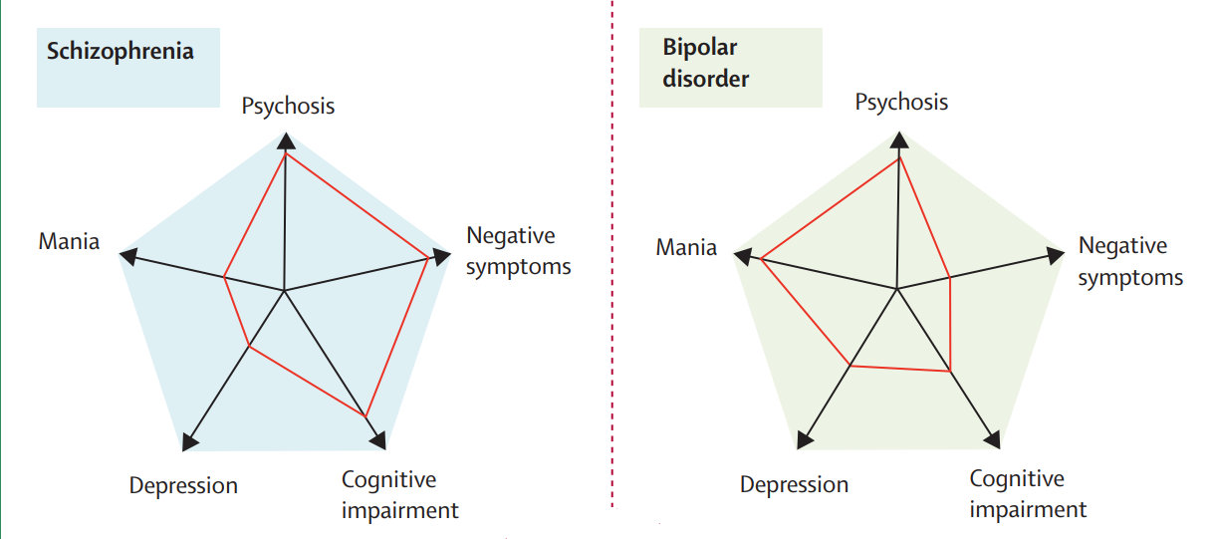
c. Psychopathology: Scientific Knowledge
The Lancet, Vol 374 August 22, 2009, 637.

Slide 6
d. The Ethical Theoretical Issue – Our Focus
Professional applications of ethics lack the necessary conceptual tools.
We take responsibility for other people's personal development, and react judiciously with regards to mental health issues, which is an important commitment.
This makes the relative lack of attention given to adequate theoretical foundation for knowledge on mental development, the lack of conceptualization on the matter more puzzling.
This is true for ethics: poor theoretical understanding

Slide 7
What is Ethical Theory is about?
Are words being used to refer to some reality?

Slide 8
Meta-Ethics: a Short Reminder
Meta-ethics is concerned with
the semantic of the term, e.g. the words “mental health” suggest a variety of possible propositions depending on how we define the mind and/or health.
The method of knowledge: are we basing our results on the mind and on health on introspection, on other type of reflective data, is it on testimony or anamnesis, on case studies, based on a report drawn from a list of pharmacological substances prescribed to the patient, on the behavioural analysis, the phenomenology of the type of psychopathology, etc.
The nature of the knowledge
The ontology related to our field of the enquiry of the human being, of the ‘natural’ properties.

Slide 9
A. Bios –Ethos: Explanation and Comprehension
Mental Health Sciences reduce the holistic and comprehensive dimension of the person to purely behavioural, causal, mechanical or measurable factors and explanations.
1) Integrative medicine in psychiatry provides an ethical holistic and comprehensive approach to mental health, considers non measurable factors present in human beings.
To focus on the doctor-patient relationship.
Eventually to think our reason in new ways, gathered from insights in philosophy
2) Applying ethics across a wide variety of professional fields related to mental health and psychological development.

Slide 10
Back to University: Assessment of Ethical Statements
3) Schizophrenia challenges the assessment of ethical statements, where ethical statements should be taken from psychopathology, and brought back to meta-ethics (back to higher education institutions).
Theory in ethics is pointing at the merit or the bias of the method, the precision or vagueness of the semantic when ethical statements are “applied” in practice, which should have an ethical theoretical value, prior to the application or instrumental practical use of it.

Slide 11
B. Virtue Epistemology: Virtues, Vices and the Problem of the Human Mental Illness
Meta-ethics can focus on ethical character or virtue ethics
Virtue epistemology is a philosophical approach to the method of knowledge formation in relation to virtue ethics.
Intellectual virtues can be understood as one group of virtues (or vices), when we take them in theory (analytic method).
On the contrary: Inclusive virtue epistemology is when practice and theory form a holistic unity. What is true for P what is true of T.
Epistemology as integrated and directly dependant from mainly practical and pragmatically oriented views.

Slide 12
Schizophrenia as Indifference and as a Vice for the Character Formation
The vice of indifference: Lat: acedia, Gr: ἀκηδία, negligence, ἀ- lack of -κηδία care; laziness, sloth.
It could be understood in a structural interdependency to other important vices such as the other six deadly sins.

Slide 13
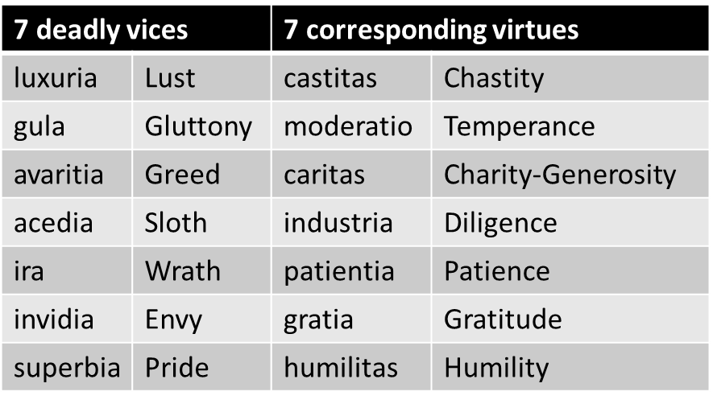
Inclusive View: Common Vices

Slide 14
Incipit Parodia
Five Sloth Commandments: Indifference as the Highest Good
S Sit instead of stand. Everything can come to you
L Let yourself go. Say goodbye to everything that keeps you tightly
wound.
O Open your mouth and let anything you feel like enter. Once you
stop restricting intake, food will become more pleasurable
T Toil no more. For god's sake, stop working unless it is something
you can do lying down
H Happiness is within me. I don't have to work at it.

Slide 15

“Life is much better when we don’t give a damn.”
(or other words of the same effect!)
Indifference is stylish!

Slide 16
Sloth and Indifference as Vices
Reductio ad absurdum of the trend for indifference
History of art around the theme of indifference as laziness.
Possible ethical consequences of choosing indifference in the lying position.

Slide 17

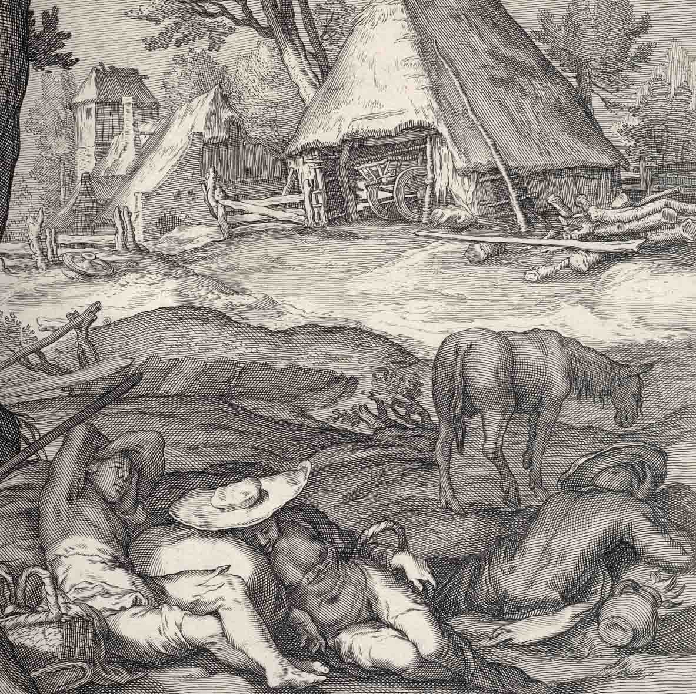
Sloth as an Economic Risk

Slide 18
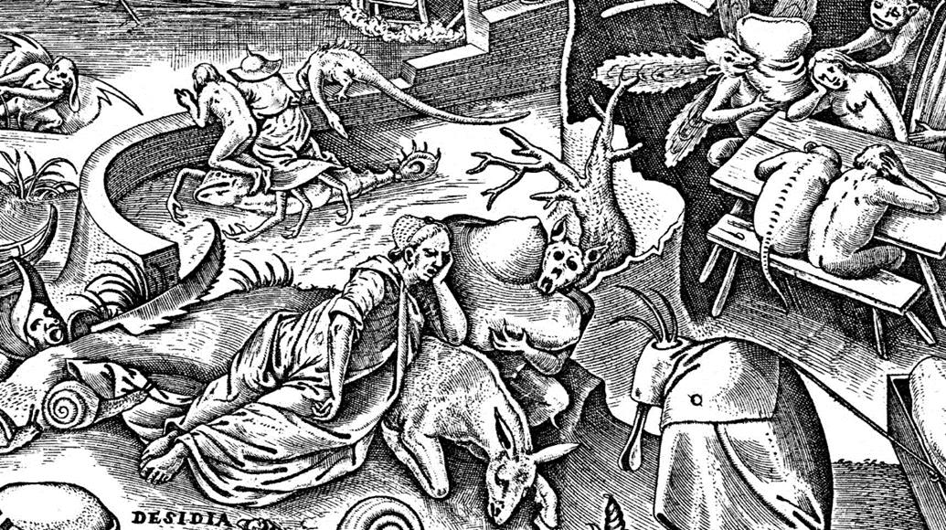
Sloth as Mental Health Risk and Intellectual Vice/Educational Risk
-With P. Bruegel, indifferent ways of life become clearly associated with pain. Sloth is described as dealing with some specific evil consequences: the person who rests his head on a cushion, held by monsters, suggest eventually that indifference is associated with mental health risk.
-The main character sits next to a donkey. Intelligence preferably develops in a being who either sits, or is in a vertical position. Indifference vs. education and knowledge

Slide 19
C. Relativism: Neither Concerned by Truth, by Method nor by Truthfulness?
Virtues and vices do not communicate the reflection of our dreams any more than that of our nightmares. Dreams mirror but are also deformation of the ethics of virtue and might well deceive us.
According to the Relativist, the beautiful image that we see there is only the one we have (power=only reality), and it is there because we project it there, according to social historical conditions (e.g. with Marx),
our projections only contribute to shift our attention from what is essential. The crucial question is two fold:
  1) If applied to mental health, what role truth plays in defining our method?
  2) What are our standards of truthfulness?

Slide 20
D. Sloth and Indifference as Deeper into Theoretical Ethics Related Vices
Aristotelian taxonomy of virtues and vices
-Indifference as vice by default of the virtue of impartiality, typically an intellectual quality of the mind.
-It is correlative to the vice by excess of partiality, virtue being the middle position between two excesses
(Cf. Engel, P. Les vices intellectu-els, p.299).
Vices by default | Virtues | Vices by excess
Indifference | Impartiality | Partiality
Narrowness | Sobriety | Debauchery
Contempt of self | Humility | Pride
Cowardice | Courage | Temerity
Dispersion | Relevance | Obsession
Laxity | Reflexive equilibrium | Rigidity

Slide 21
E. Sloth and Indifference as Intellectual Vices
The initial motivation for an inquiry is the astonishment (ethical or cognitive)
In the ethical application of the motivation: to be scrupulous is a necessary condition for applying the initial ethical motivation to any empirical enquiry area or to any professional sector
Impartial openness is necessary for the assessment of results of a process of enquiry which has as initial motivation the astonishment, and as application of the motivation scruple.
***
The related vices are sloth and indifference as the lack of the very first motivating kick off, lack of astonishment, and lack of learning attitudes.
Lack of scrupulousness in the realization of the enquiry (as in plagiarism, manipulation)
Closure and dogmatism contrary to impartial openness, on the level of the assessment, of the results of the research.

Slide 22
Indifference as a Vice
Is further associated with:
Lack of curiosity
Obtuse character
Lack of attention
Intellectual weakness
Lack of objectivity
Poor observation dispositions
Insensibility to details
Disposition of taking one’s desires for realities
Prone to prejudice
Lack of care
Conformism

Slide 23
F. Medical Care
As a ‘natural’ kind, or as a descriptive ethical phenomenon constituted as the way of life of the schizophrenic patient, indifference should not be considered as a vice but an illness, and indifferent persons should in consequence not be stigmatized as they would have the choice of behaving differently. Patients should be assisted in professional health and paramedical structures. It is the duty of a decent society to protect those who are the worse off by means of a judicious systems of insurances and dynamic processes toward the remission of schizophrenic mental illness, and the integration active professional life.

Slide 24

Ignace Haaz
Concluding Remarks
Mental Health Ethics
A Glance into the Virtue Epistemology of Indifference and Schizophrenia
As Descartes rightly said, we can admire horror as we admire beauty, but truth, knowledge and ethical virtue depend on what we build our admiration on and everyone can think at his personal experience. Ethical knowledge brings conceptual clarity on complicated either factual or ethical normative perspectives.
Discover our Globethics.net book on mental health ethics!
Discover our Ethics in higher education Library resources and services:
Globethics.net Library resources, the three Research Ethics Collections
Globethics.net Library resources on Health Ethics

Slide 25
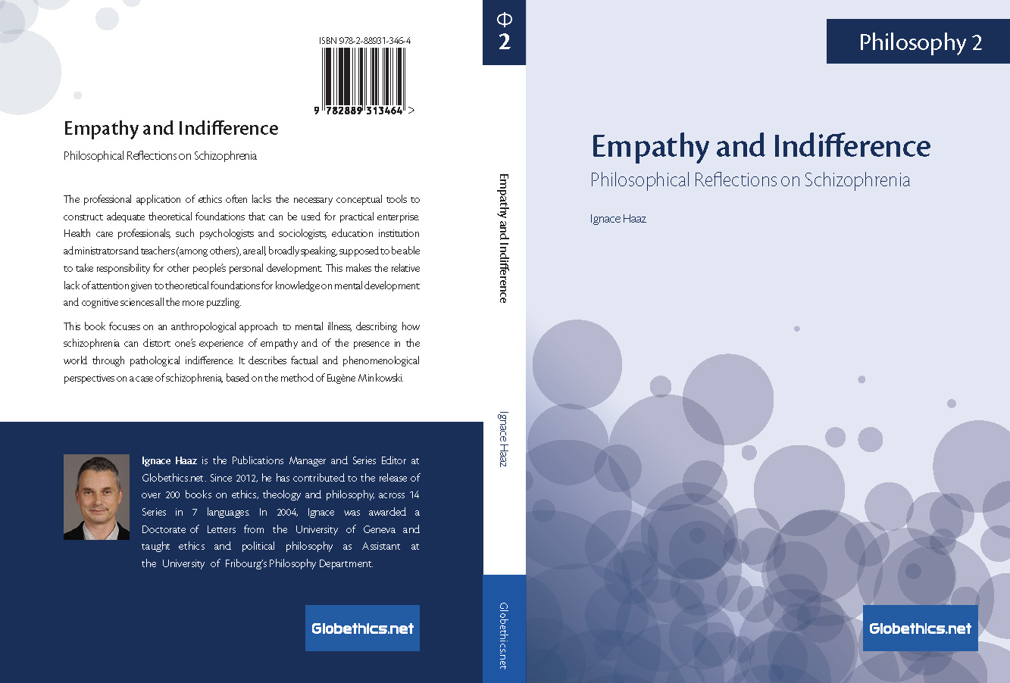
New Globethics.net Publication!

